Slide 1

Developing the first Neural Network with TensorFlow
Presented By:
Sujan Kumar Roy, Ph. D., M. A. Sc., M. Sc.
Associate Professor,
Department of Computer Science & Engineering
University of Rajshahi, Bangladesh
Nationality: Bangladeshi
http://rurfid.ru.ac.bd/ru_profile/public/teacher/22706109/profile

Slide 2
Outlines
Introduction to Neural Network
Design, Implement, Training
Design a simple NN to demonstration prediction
Python, TensorFlow, and Keras to Design NN
Learn how to run/execute NN on Colab Platform
Task to be completed Today.
Ref: https://medium.com/mlearning-ai/developing-the-first-neural-network-with-tensorflow-5fade1a23395
1

Slide 3
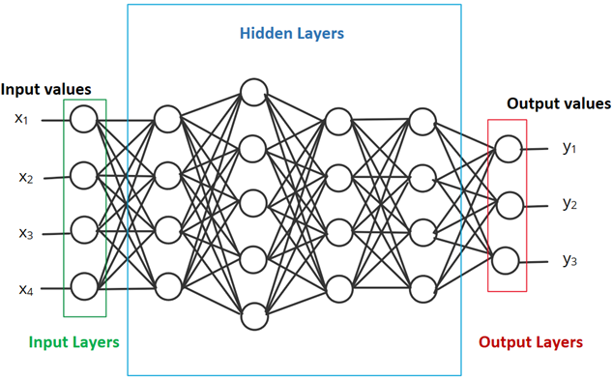
First Neural Network
Neural Networks
A neural network is a type of model that can be trained to recognize patterns.
It is composed of layers, including input and output layers, and at least one hidden layer
Deep neural network containing more than one hidden layer.
1

Slide 4
Outlines
Training the Neural Network
Neural networks are trained by gradient descent.
The weights in each layer begin with random values, and these are iteratively improved over time to make the network more accurate.
A loss function is used to quantify how inaccurate the network is, and
Backpropagation is used to determine whether each weight should be increased, or decreased, to reduce the loss.
1

Slide 5
Outlines
Developing a Neural Network
Python is one of the most popular programming languages for creating Machine learning algorithms.
TensorFlow
TensorFlow is an open-source library developed by Google primarily for machine learning applications making it easy to build and deploy ML models.
Colab
Colaboratory is a Google product, similar to Jupyter notebook, allows to write and execute python code through the browser.
1

Slide 6
Outlines
Model Definition
The first model we will develop is going to be really easy but it will be useful to understand how to create, configure, train the model and finally use it to give us a prediction.
Suppose we have the following sets of numbers. We want to create a Neural -Network that can understand the relationship y=3x-7.
1

Slide 7
Outlines
Model Definition
The first step is to gather the data: so let’s save these the values for the x and y in two different numpy arrays.
# Import numpy
import numpy as np
# y = 3x -7
x = np.array([-1.0, 0.0, 1.0, 2.0, 3.0, 4.0, 5.0], dtype=float)
y = np.array([-10.0, -7.0, -4.0, -1.0, 2.0, 5.0, 7.0], dtype=float)
1

Slide 8
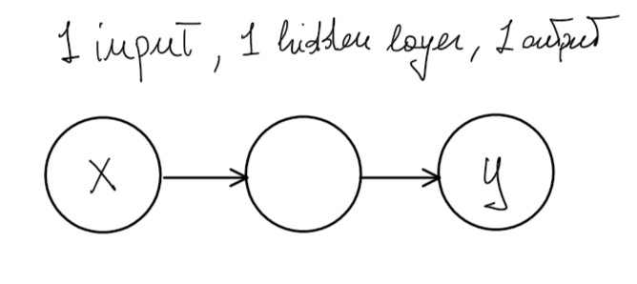
Outlines
Creating the simplest Neural Network:
The simplest NN we can create has just 1 input, 1 output and 1 hidden layer with just one node.
1

Slide 9
Outlines
Creating the simplest Neural Network:
In order to create such model using TensorFlow, we first define the Neural Network as Sequential.
It will have a sequence of layers, then we just add to it a dense layer which will represent our hidden layer.
from tensorflow.keras.layers import Dense
model = tf.keras.Sequential([Dense(units=1, input_shape=[1])])
1

Slide 10
Outlines
Creating the simplest Neural Network:
Once the model is created, losses and metrics is configured with model.compile(),
the model can be trained with model.fit(),
evaluated with model.evaluate() and
used to do prediction with model.predict().
model.compile(optimizer='sgd', loss='mean_squared_error')
model.fit(x, y, epochs=500)
print(model.predict([25.0]))
1

Slide 11
Outlines
Final Neural Network Code:
# Imports
import tensorflow as tf
from tensorflow.keras.layers import Dense
import numpy as np
model = tf.keras.Sequential([keras.layers.Dense(units=1, input_shape=[1])])
model.compile(optimizer='sgd', loss='mean_squared_error')
# y = 3x -7
x = np.array([-1.0, 0.0, 1.0, 2.0, 3.0, 4.0], dtype=float)
y = np.array([-10.0, -7.0, -4.0, -1.0, 2.0, 5.0], dtype=float)
model.fit(x, y, epochs=500)
print(model.predict([10.0]))
1

Slide 12
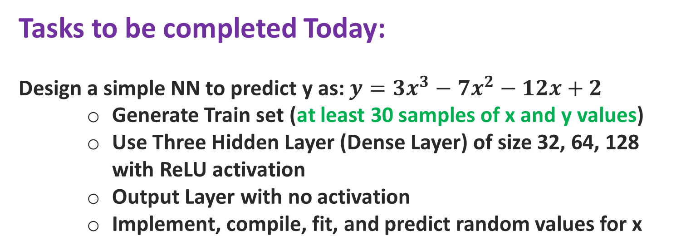
Outlines
Tasks to be completed Today:
Design a simple NN to predict y as: $y=3x^{3}−7x^{2}−12x+2$
Generate Train set (at least 30 samples of x and y values)
Use Three Hidden Layer (Dense Layer) of size 32, 64, 128 with ReLU activation
Output Layer with no activation
Implement, compile, fit, and predict random values for x
1

